Slide 1
Programming fundamentals
Lecture 20: Array of pointers, Dynamic Allocation Using new and delete, pass by pointers , functions and pointers

Slide 2
Recap
Pointers and arrays

Slide 3
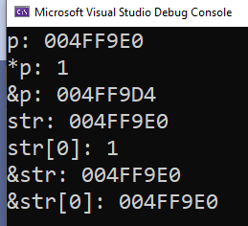
Pointers and Arrays
Since array’s name depicts base address therefore we can assign it to a pointer.
Provided that array type and pointer type matches
#include <iostream>
using namespace std;
int main()
{
int arr[4] = {1,2,3,4};
int* p;
p = arr;
cout << "p: " << p << endl;
cout << "*p: " << *p << endl;
cout << "&p: " << &p << endl;
cout << "str: " << arr << endl;
cout << "str[0]: " << arr[0] << endl;
cout << "&str: " << &arr << endl;
cout << "&str[0]: " << &arr[0] << endl;
return 0;
}

Slide 4
Accessing any element of an array with a pointer
p1 = str assigns the address of str[0] to p1
Since, after the assignment, p1 points to the beginning of str, you may use p1 to
access elements in the array. For example, if you want to access the fifth element in
str, you could use
str[4]
or
*(p1+4)
#include <iostream>
using namespace std;
int main()
{
char str[80];
char* p1;
p1 = str;
}
* ( p1+4 )
The parentheses surrounding p1+4 are necessary because the * operation has a higher priority than the + operation.
Without the parentheses, the expression would first find the value pointed to by p1 (the first location in the array) and then add 4 to it.
Value
Address

Slide 5
Are Pointers and Arrays Interchangeable?
pointers and arrays are not completely interchangeable
#include <iostream>
using namespace std;
int main()
{
int num[10]; int* p;
int i;
p = num;
for (i = 0; i < 10; i++) {
p++; // this is OK
num++; // ERROR -- cannot modify num
}
}
You cannot increment base address by simply using array name. But, you can increment pointer

Slide 6
Agenda
Array of pointers
Multiple indirections
Initializing a pointer
The Null Pointer Convention
Dynamic Allocation Using new and delete
Pass by pointer
Using pointers in functions

Slide 7
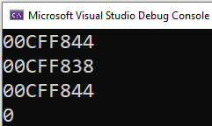
Arrays of Pointers
P[0]
P[1]
P[2]
00CFF838 | 00CFF888 | 00CFF788
00CFF844 | 00CFF848 | 00CFF852
#include <iostream>
using namespace std;
int main()
{
int* p[3];
int x = 0, y = 1, z = 2;
p[0] = &x;
p[1] = &y;
p[2] = &z;
cout << p << endl;
cout << p[0] << endl;
cout << &p[0] << endl;
cout << *p[0] << endl;
}
x
y
z
0
00CFF838
1
00CFF888
2
00CFF788

Slide 8
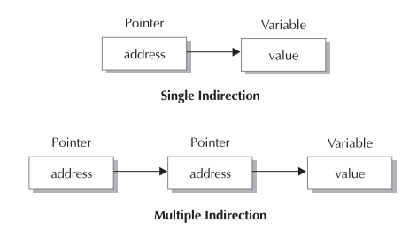
Multiple indirections
A pointer to a pointer is a form of multiple indirection, or a chain of pointers.

Slide 9
Int Variable
Pointer Variable
Pointer Variable
#include <iostream>
using namespace std;
int main()
{
int x, y, * p, ** q;
x = 10; y=12;
p = &x;
q = &p;
return 0;
}
Int Variable
x
p
q
y
10
0001
0001
00FFF
00FFF
00FE0
12
0030
p = &x
Pointer to int (address) address of int variable
Valid
x = y
Int value Int value
q
Pointer to pointer (address)
Valid
&x (address of int variable)
=
Invalid
x = &y
Int value address of int variable
Invalid

Slide 10
Multiple indirections
Int Variable
y
12
0030
#include <iostream>
using namespace std;
int main()
{
int x, y, * p, ** q;
x = 10; y=12;
p = &x;
q = &p;
cout << *q; // prints the value of p
cout << **q; // prints the value of x
return 0;
}
Int Variable
Pointer Variable
Pointer Variable
x
p
q
10
0001
0001
00FFF
00FFF
00FE0
x = y
Int Int variable
variable
0001
Valid
10
x = &y
Int Int variable
variable

Slide 11
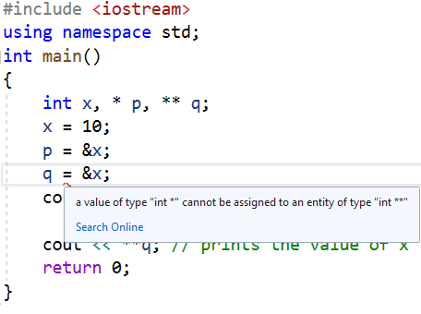
q
We cannot assign * to **
00FFF
00FE0
Not allowed
x
p
10
0001
0001
00FFF

Slide 12
Pointer initialization is must!
Just as we must make sure to initialize or define variables, the same applies to pointers
#include <iostream>
using namespace std;
int main()
{
int x, *p;
x = 10;
*p = x; // where does p point?
return 0;
}
ERROR

Slide 13
The Null Pointer Convention
there is no sure way to avoid using an uninitialized pointer, C++ programmers have adopted a procedure that helps prevent some errors.
By convention, if a pointer contains the null (zero) value, it is assumed to point to nothing.
Thus, if all unused pointers are given the null value and you avoid the use of a null pointer, you can avoid the accidental misuse of an uninitialized pointer.
This is a good practice to follow.
float *p = 0; // p is now a null pointer
To check for a null pointer, use an if statement, like one of these:
if(p) // succeeds if p is not null
if(!p) // succeeds if p is null

Slide 14
Dynamic memory allocation

Slide 15
There are two primary ways in which a C++ program can store information in the main memory of the computer.
Static memory allocation in which you cannot change memory at runtime. Memory is allocated at compiler time (stack)
Dynamic memory allocation in which memory is allocated at run time (heap)
Dynamic memory allocated is possible with the help of pointers!
Dynamic allocation is an important part of nearly all real-world programs
linked lists, graphs (used in modeling facebook like applications) and binary trees work on this concept

Slide 16
new and delete keyword
C++ contains two operators, new and delete, that perform the functions of allocating and freeing memory.
Their general forms are shown here:
pointer-var = new var-type;
delete pointer-var;
Here, pointer-var is a pointer of type var-type. The new operator allocates sufficient memory to hold a value of type var-type and returns a pointer to it. Any valid data type can be allocated using new.
The delete operator frees the memory pointed to by pointer-var. Once freed, this memory can be reallocated to different purposes by a subsequent new allocation request.

Slide 17
Dynamic memory allocation
#include <iostream>
using namespace std;
int main()
{
int* p;
p = new int; // allocate memory for int
*p = 20; // assign that memory the value 20
cout << *p; // prove that it works by displaying value
delete p; // free the memory
return 0;
}

Slide 18
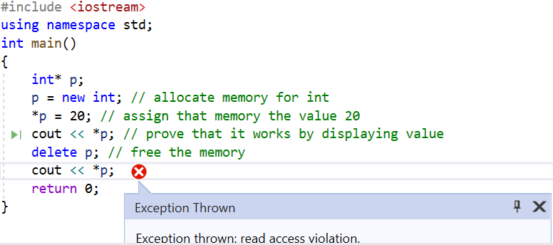
What if we try to access memory after deleting it? Exception will be thrown!

Slide 19
Initializing dynamically allocated memory
#include <iostream>
using namespace std;
int main()
{
int* p;
p = new int(99); // initialize with 99
cout << *p; // displays 99
delete p;
return 0;
}

Slide 20
Allocating arrays
Everything is same as we have done for allocating one memory location dynamically.
Now we are going to explore how to allocate arrays
Syntax for allocating and deallocating memory for arrays is:
pointer-var = new type [size];
delete [ ] pointer-var;

Slide 21
#include <iostream>
using namespace std;
int main()
{
int* p;
int i;
p = new int[10]; // get a 10-element array
for (i = 0; i < 10; i++)
p[i] = i;
delete[] p; // delete the entire array
return 0;
}
0 | 1 | 2 | 3 | 4 | 5 | 6 | 7 | 8 | 9
0000 | 0004 | 0008 | 0012 | 0016 | 0020 | 0024 | 0028 | 0032 | 0036
p

Slide 22
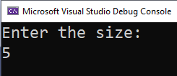
You can now have user defined size array with dynamic allocation
#include <iostream>
using namespace std;
int main()
{
int* p;
int size = 0;
cout << "Enter the size:" << endl;
cin >> size;
p = new int[size]; // get a 10-element array
for (int i = 0; i < size; i++)
p[i] = i;
delete[] p; // delete the entire array
return 0;
}
Make sure to access only those memory that you allocated, otherwise your compiler will give exception in this case

Slide 23
Pointers in functions
C++ allows you to pass a pointer to a function.

Slide 24
Example 1: pointer = variable’s address assignment
Pass by Pointer
#include <iostream>
using namespace std;
void printAge(int* age);
int main() {
int num = 26;
int* age;
age = &num;
return 0;
}
num
age
26
010FFC7C
010FFC7C
010FFBA8

Slide 25
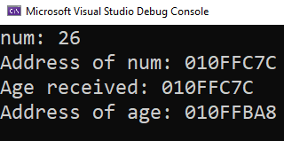
Example 1
#include <iostream>
using namespace std;
void func(int *age);
int main() {
int num=26;
cout << "num: " << num << endl;
cout << "Address of num: " << &num << endl;
func(&num);
return 0;
}
void func(int *age) {
cout << "Age received: " << age << endl;
cout << "Address of age: " << &age << endl;
}
num
age
26
010FFC7C
010FFC7C
010FFBA8
age = &num;
pointer = address;

Slide 26
Example 2: pointer = pointer assignment
P is replicated..
(copy of p’s contents is created)
x
p
0090FB7C
0090FB70
0090FB7C
0090FA9C
#include <iostream>
using namespace std;
int main()
{
int age = 0; int* p; int* x;
p = &age;
x = p;
return 0;
}
age
0
0090FB7C
x is initialized with contents of p. That is, x also points where p was pointing. Because contents of pointer decide where to point!

Slide 27
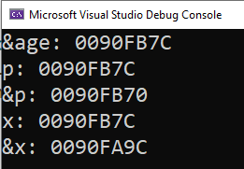
p
P is replicated..
(copy of p’s contents is created)
x
#include <iostream>
using namespace std;
void printAge(int *x);
int main() {
int age=0; int* p;
p = &age;
cout << "&age: " << &age << endl;
cout << "p: " << p << endl;
cout << "&p: " << &p << endl;
printAge(p);
return 0;
}
void printAge(int *x) {
cout << "x: " << x << endl;
cout << "&x: " << &x << endl;
}
0090FB7C
0090FB70
0090FB7C
0090FA9C
age
0
0090FB7C
x is initialized with contents of p. That is, x also points where p was pointing
x = p;
pointer = pointer;

Slide 28
Pass by reference vs
pass by pointers
Comparison

Slide 29
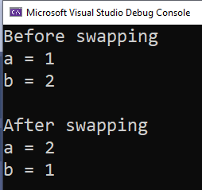
Swapping code: pass by reference..
#include <iostream>
using namespace std;
void swap(int&, int&);
int main()
{
int a = 1, b = 2;
cout << "Before swapping" << endl;
cout << "a = " << a << endl;
cout << "b = " << b << endl;
swap(a, b);
cout << "\nAfter swapping" << endl;
cout << "a = " << a << endl;
cout << "b = " << b << endl;
return 0;
}
void swap(int &n1, int &n2) {
int temp;
temp = n1;
n1 = n2;
n2 = temp;
}
a
b
1
0001
2
0010
After func call
a, n1
b, n2
1
0001
2
0010

Slide 30
Swapping code: pass by pointer..
void swap(int* n1, int* n2) {
int temp;
temp = *n1;
*n1 = *n2;
*n2 = temp;
}
#include <iostream>
using namespace std;
void swap(int*, int*);
int main()
{
int a = 1, b = 2;
cout << "Before swapping" << endl;
cout << "a = " << a << endl;
cout << "b = " << b << endl;
swap(&a, &b);
cout << "\nAfter swapping" << endl;
cout << "a = " << a << endl;
cout << "b = " << b << endl;
return 0;
}
After func call
a
b
1
0001
2
0010
n1
n2
0001
0500
0010
0600

Slide 31
Summary
No memory will be allocated for reference
Pointers, on the other hand, have their own existence in the form of memory. That is, they will be given memory by the compiler.

